Slide 1
Deep learning for multi-year ENSO forecasts
钱思萌
2019.10.31

Slide 2
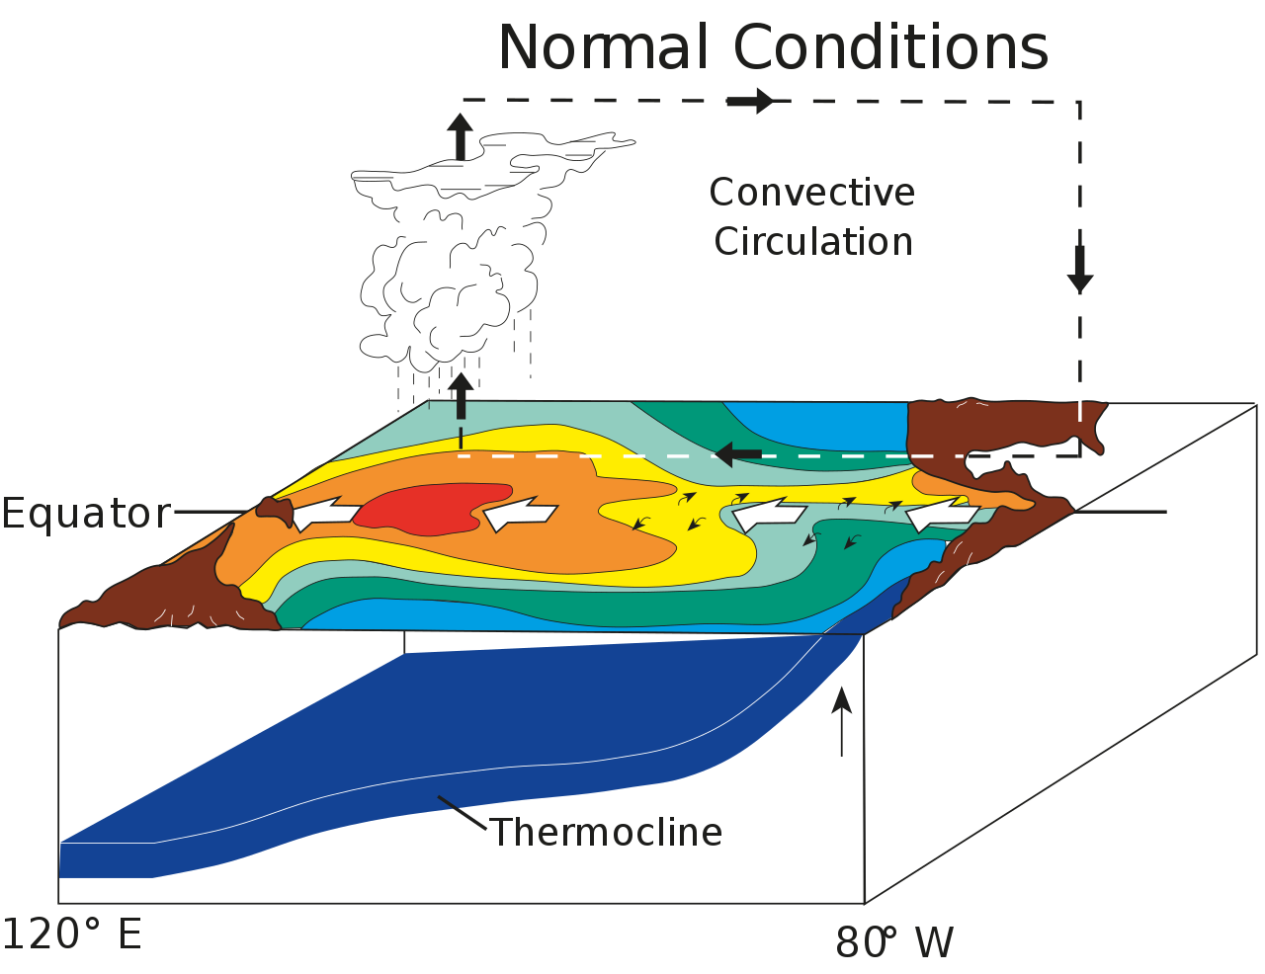
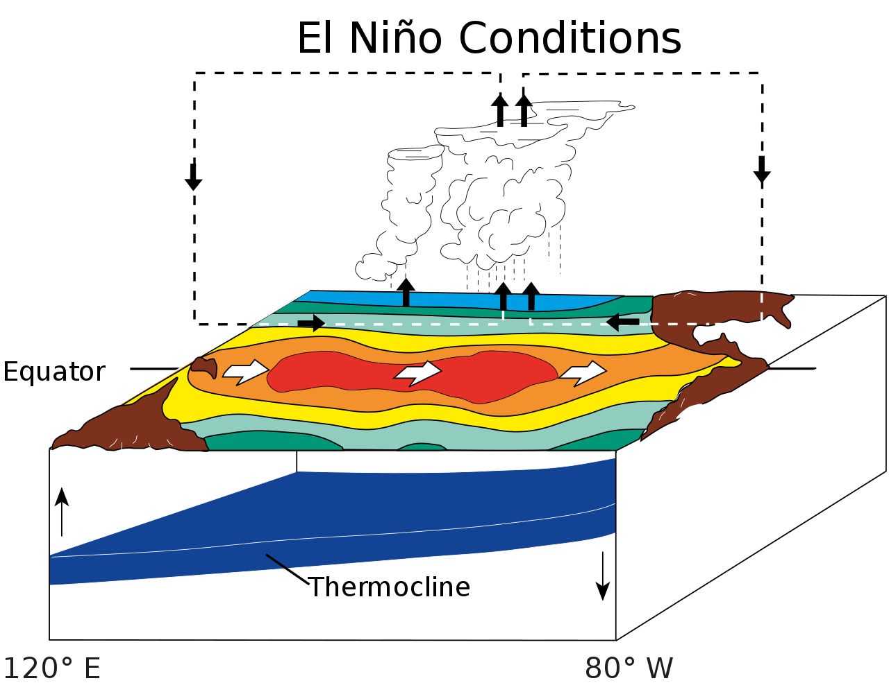
What is ENSO？

Slide 3
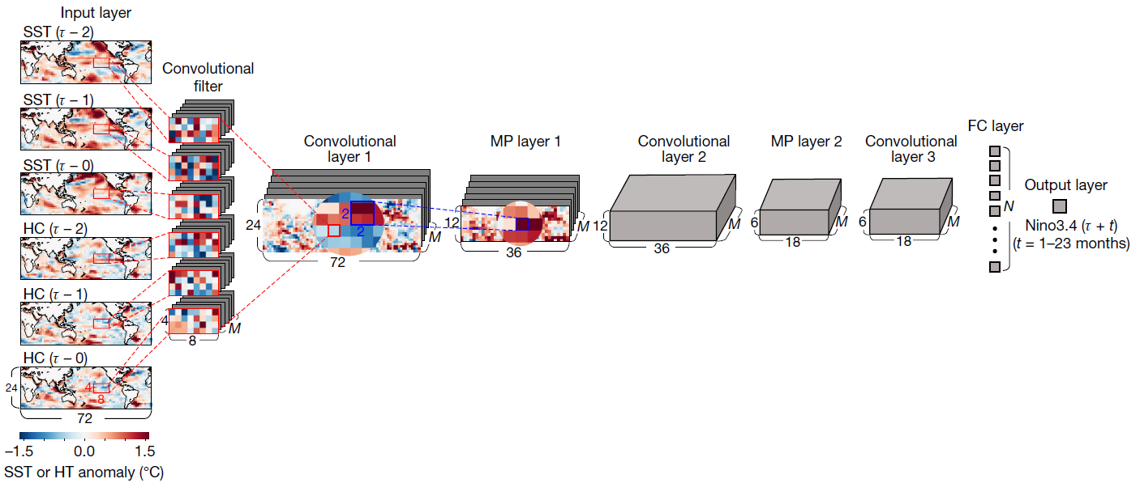
Architecture of the CNN model
Nino3.4 index: area-averaged SST anomaly over 170°–120° W, 5° S–5° N
Training Data:
CMIP5
Reanalysis: 1871-1973
Validating Data:
Reanalysis: 1984-2017
Correct systematic errors

Slide 4
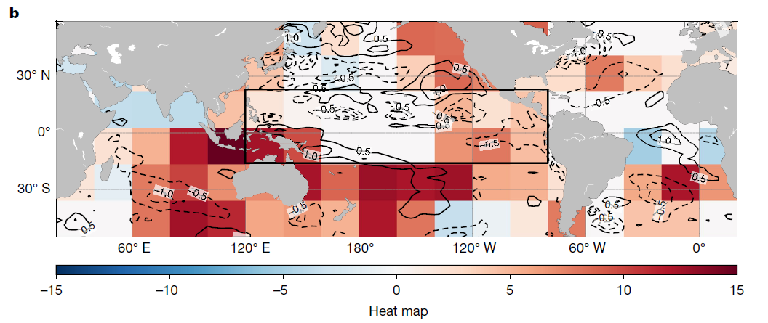

Physical interpretation of the CNN model(1997/98 El Niño )
MJJ season in 1996
Indian Ocean: negative SST anomalies westerly over the equatorial western Pacific
Southern tropical western Pacific: recharging heat contents
Subtropical Atlantic : mid-latitude Pacific variability
Heat map: quantify the contributions of the predictors at each grid point to the predictand
positive (negative) values positive (negative) Nino3.4

Slide 5
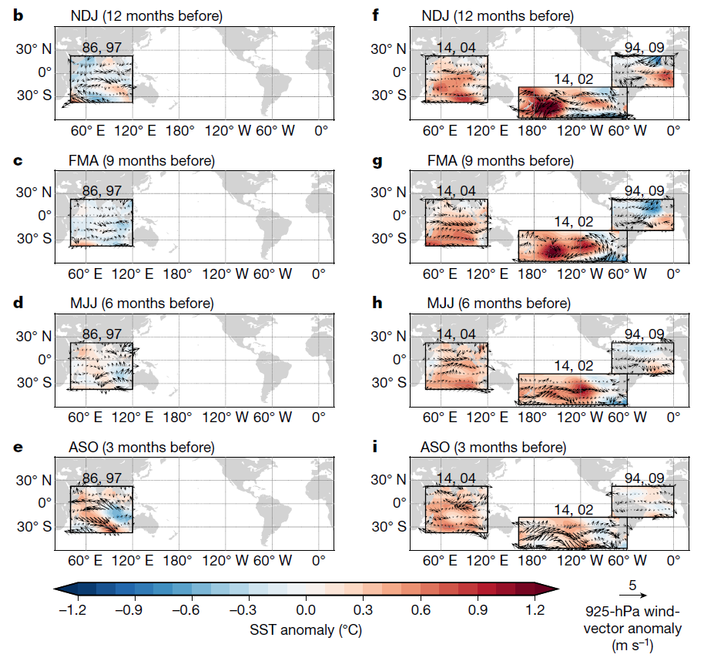
Prediction of El Niño type
EP-type
CP-type
SST cooling over the north tropical Atlantic
a positive IOD is shown one season before the El Niño mature phase

